Slide 1
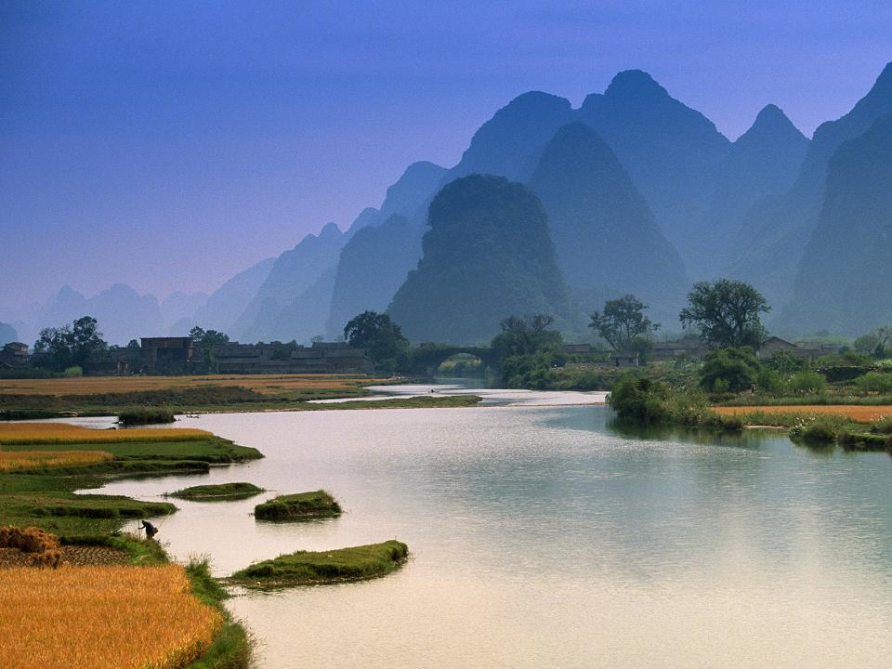
What A Wonderful World
by Louis Armstrong and Kenny G
show runs on its own.
Press enter ☺

Slide 2
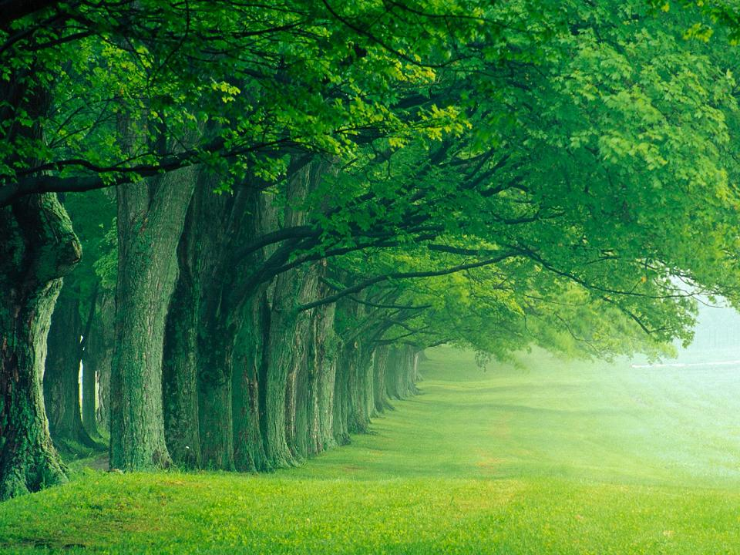
I see trees of green,

Slide 3
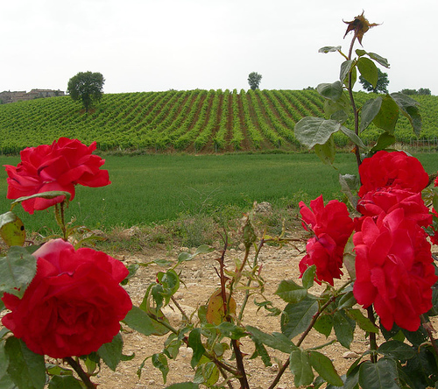
red roses too

Slide 4
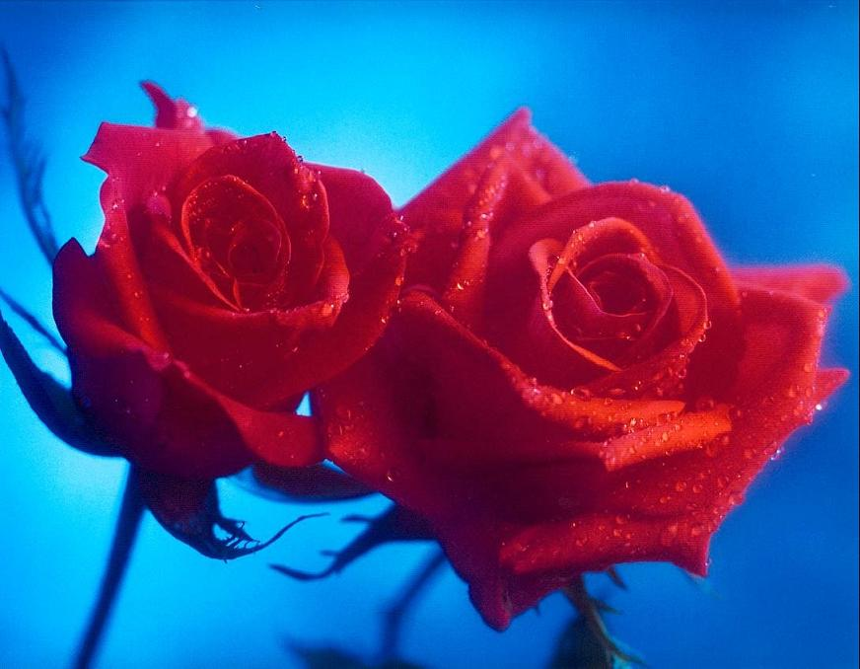
I see them bloom, for me and you

Slide 5
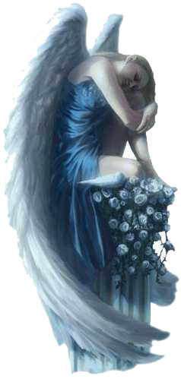
And I think to myself…

Slide 6
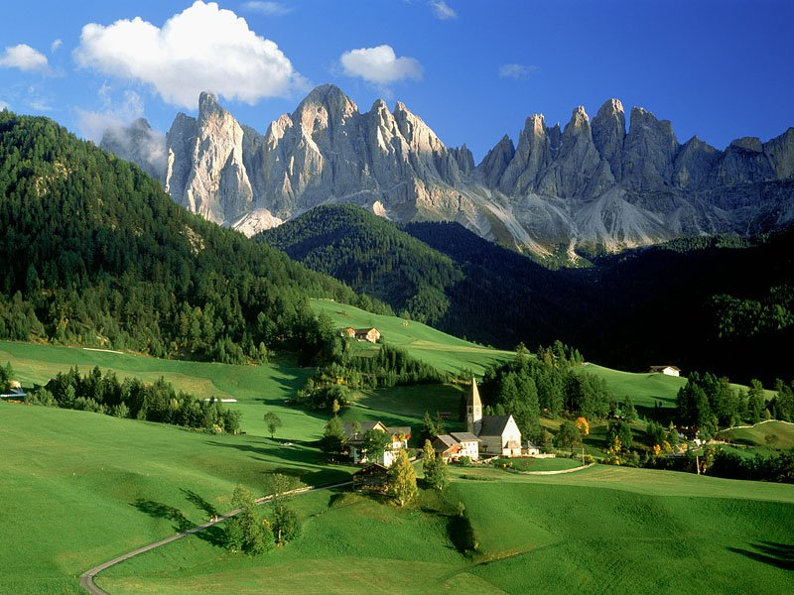
what a wonderful world

Slide 7
I see skies of blue

Slide 8
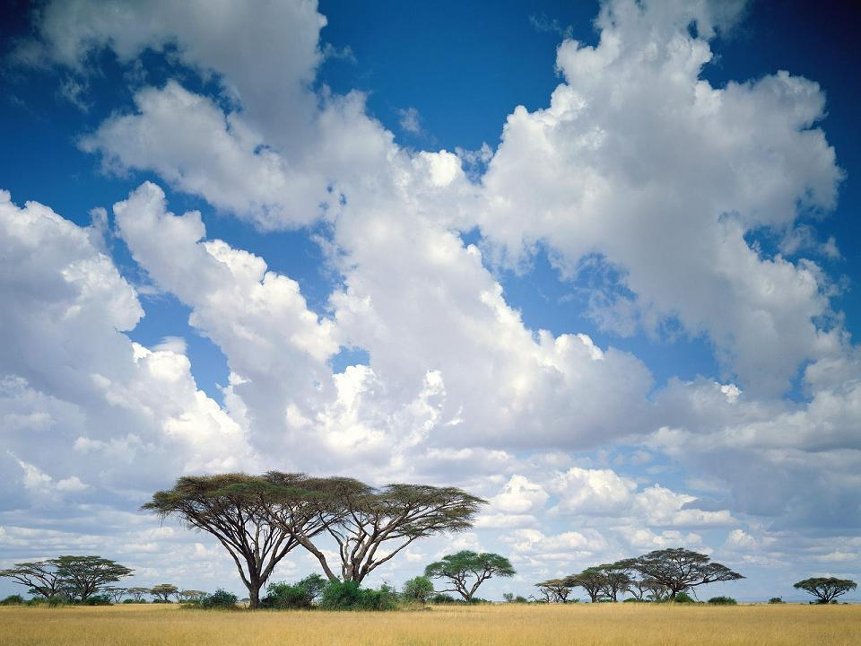
and clouds of white

Slide 9
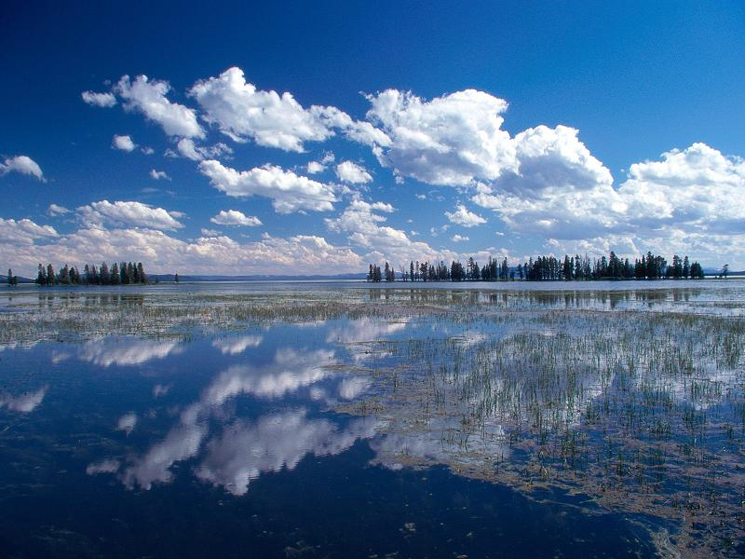
The bright blessed day,

Slide 10
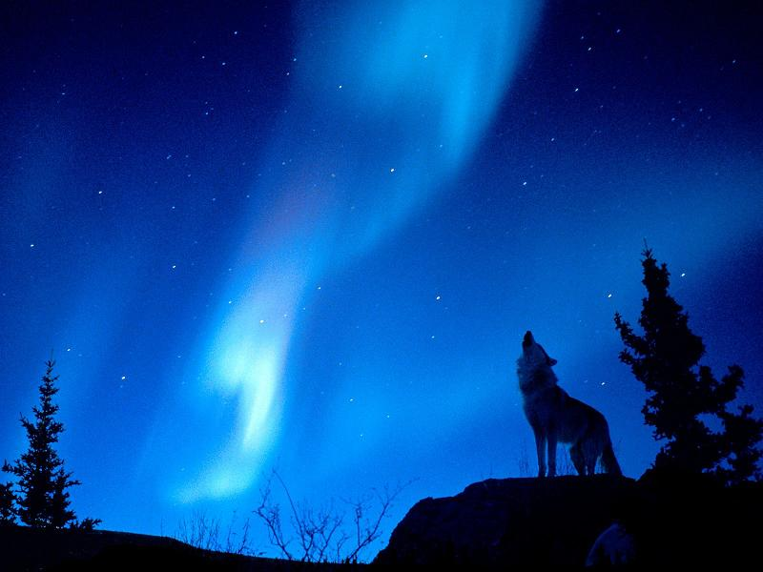
the dark sacred night

Slide 11
And I think to myself…

Slide 12
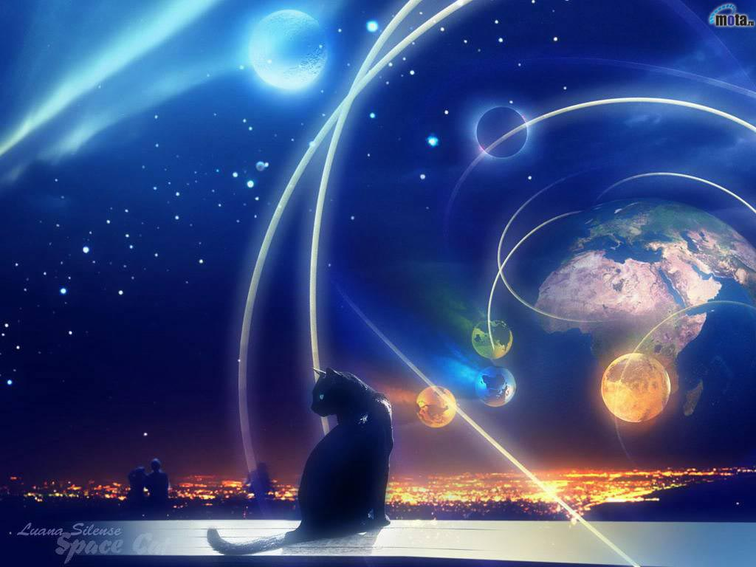
What a wonderful world

Slide 13
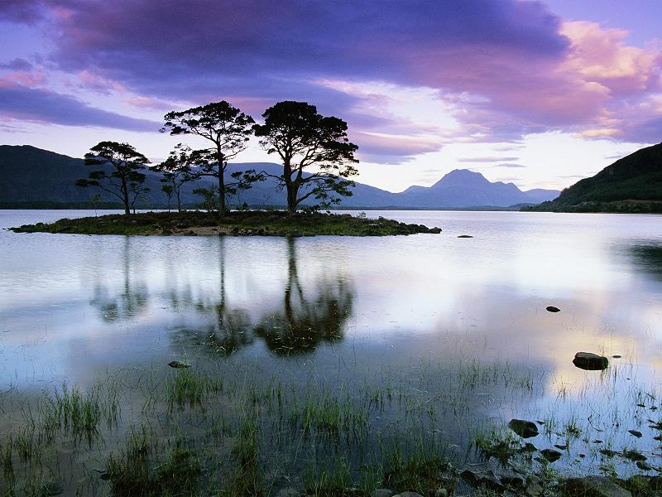

Slide 15
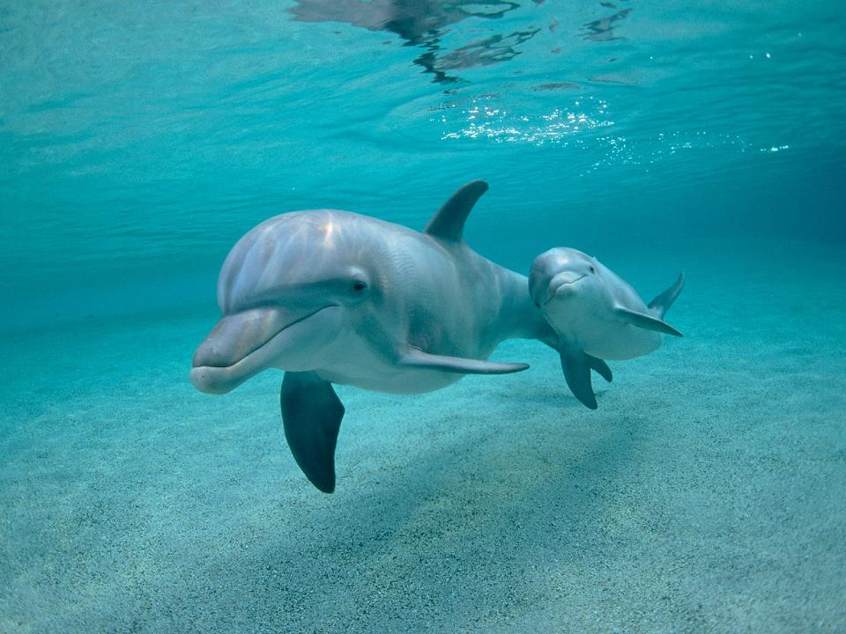

Slide 16
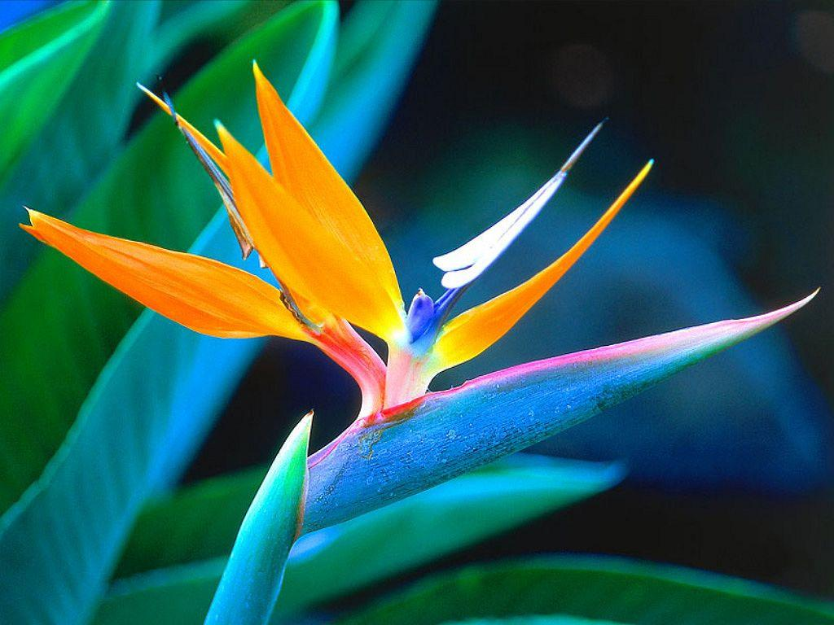

Slide 17
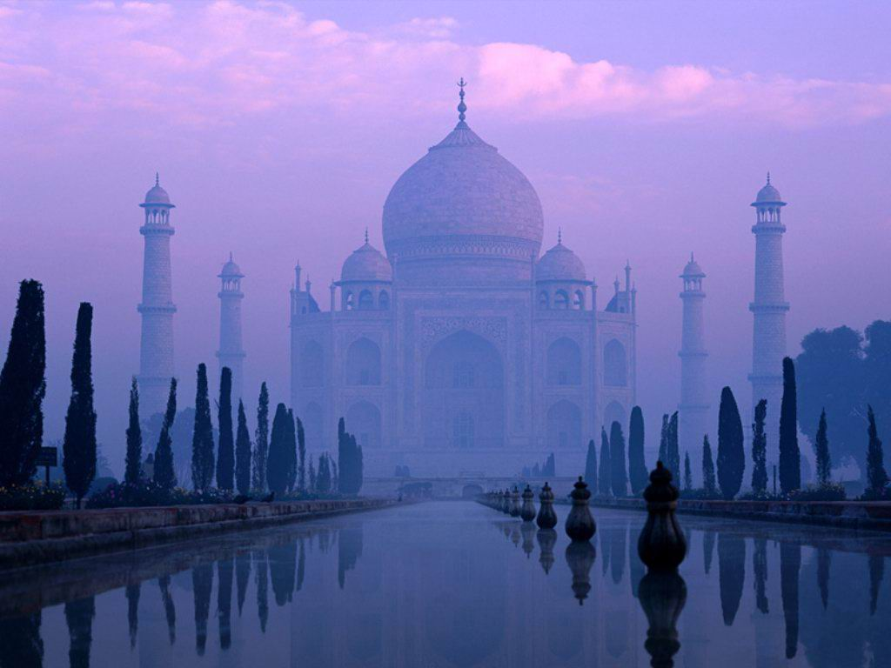

Slide 18
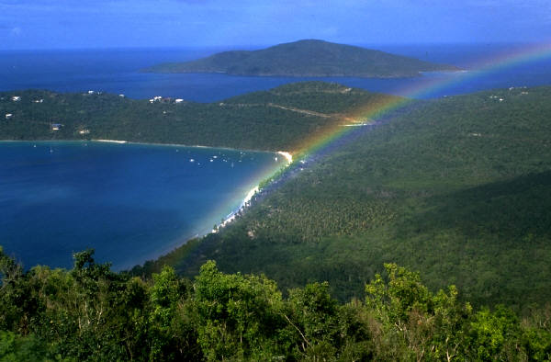
The colors of the rainbow,

Slide 19
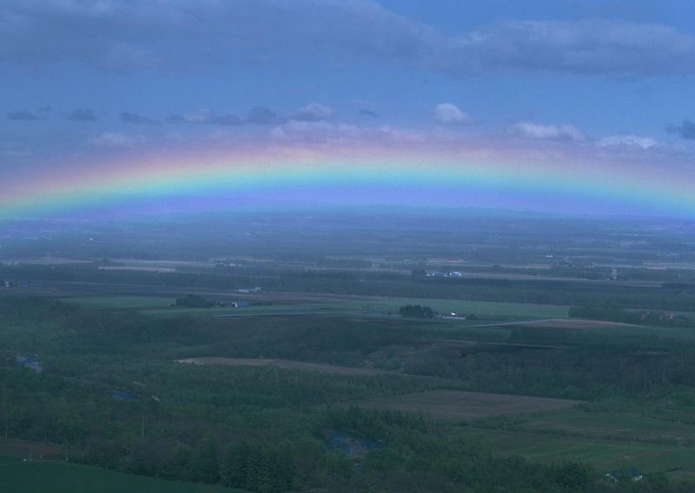
so pretty in the sky

Slide 20
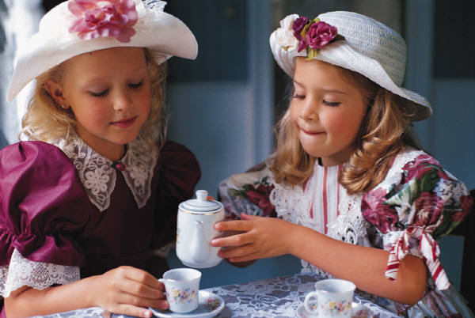
Are also on the faces

Slide 21
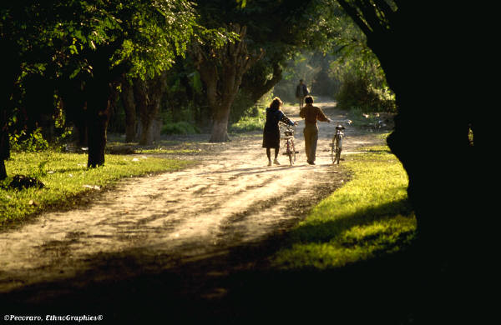
of people going by

Slide 22
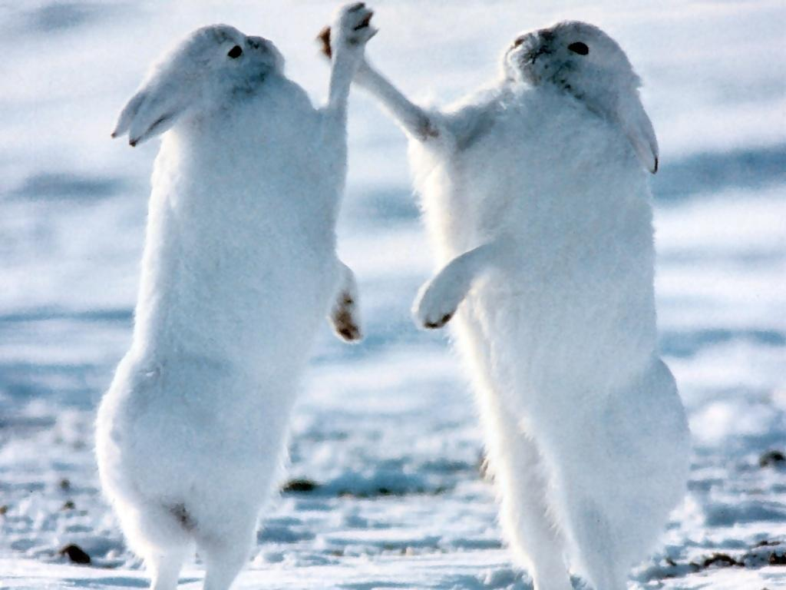
I see friends shakin' hands,

Slide 23
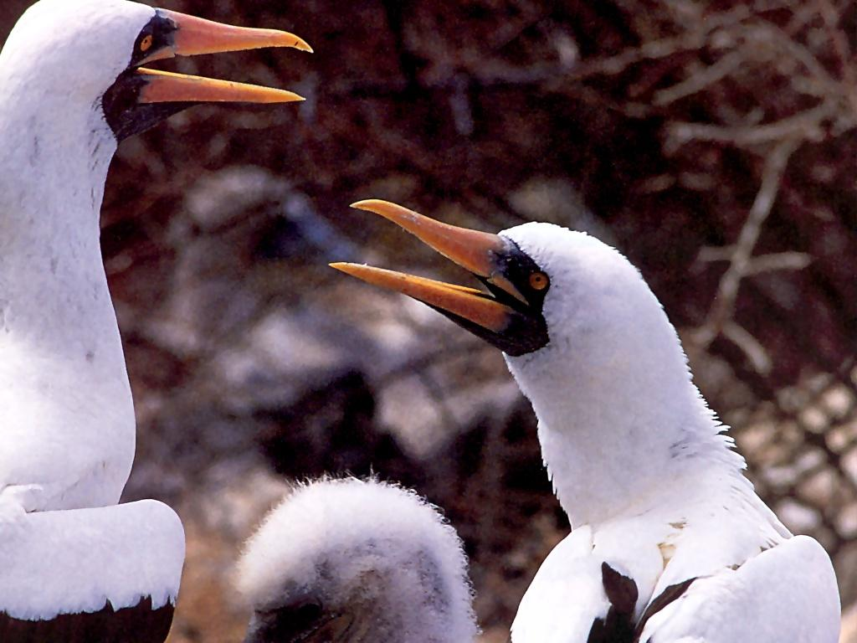
sayin' "How do you do?"

Slide 24
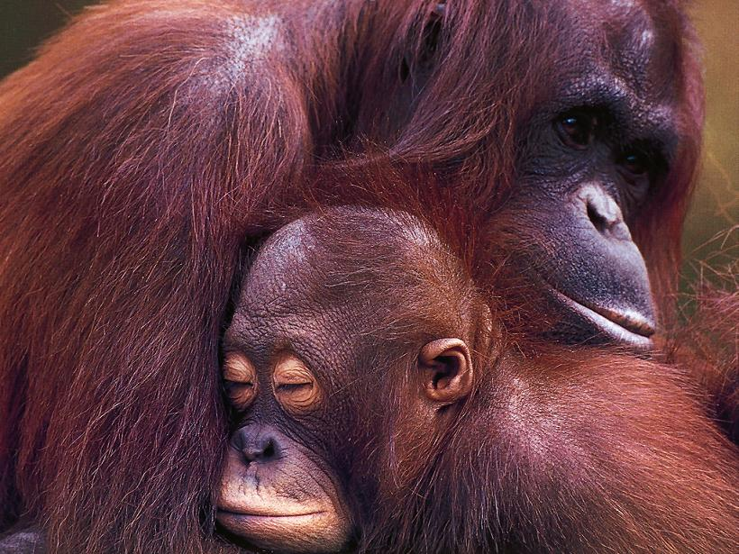
They're really saying "I love you”

Slide 25
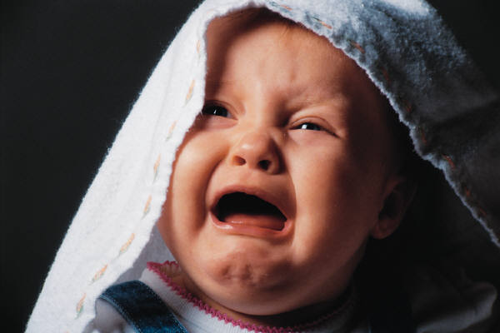
I hear babies cryin',

Slide 26
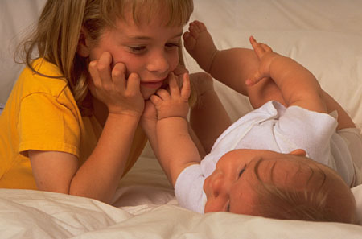
I watch them grow

Slide 27
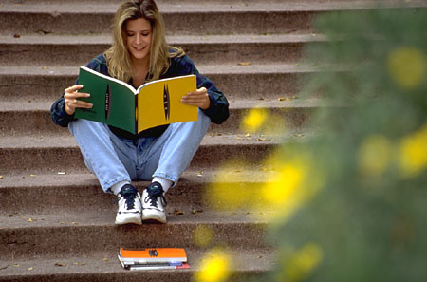
They'll learn much more

Slide 28
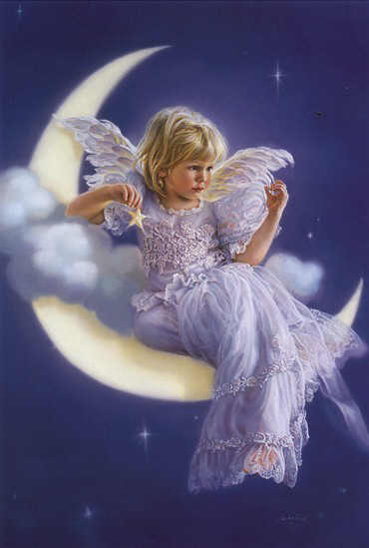
than I'll ever know

Slide 29
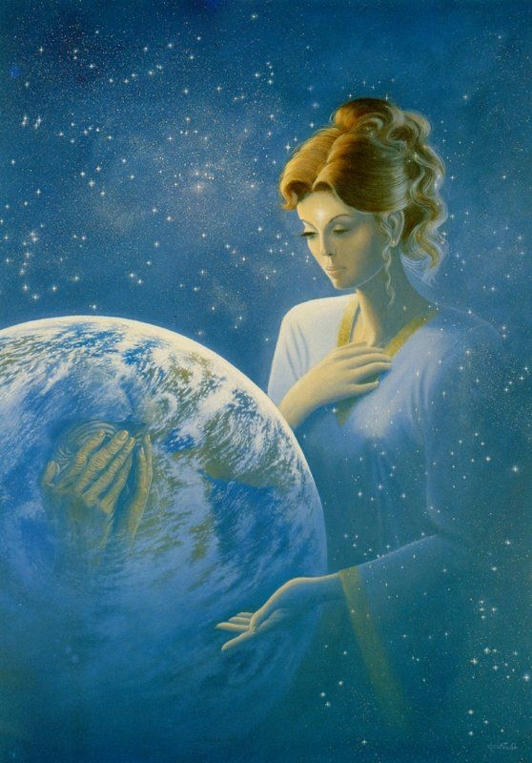
And I think to myself…

Slide 30
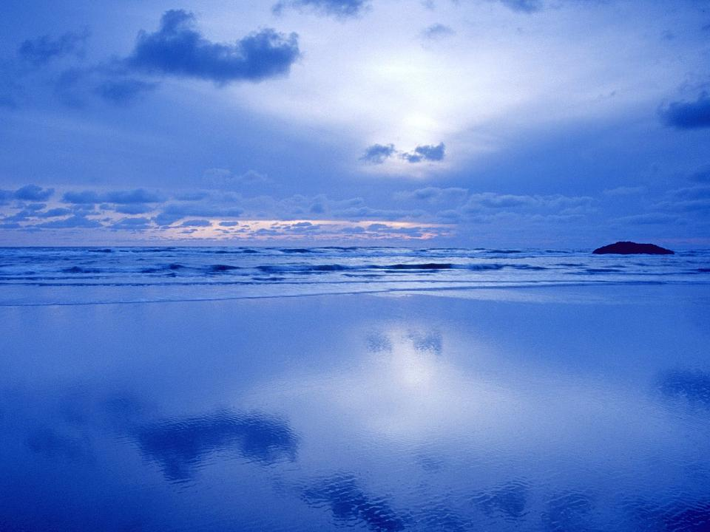
what a wonderful world.

Slide 31
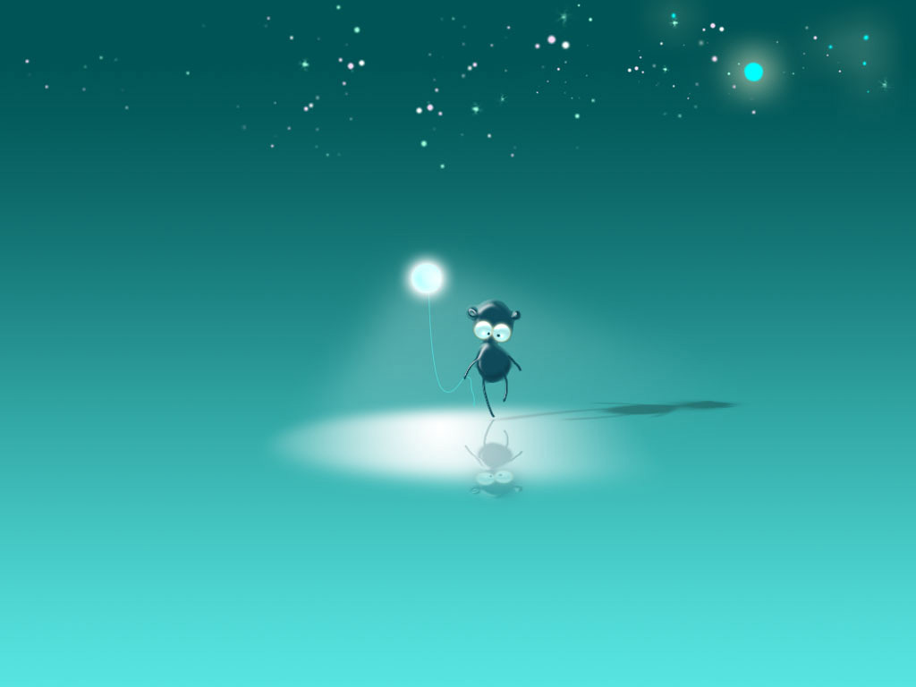
Yes, I think to myself

Slide 32
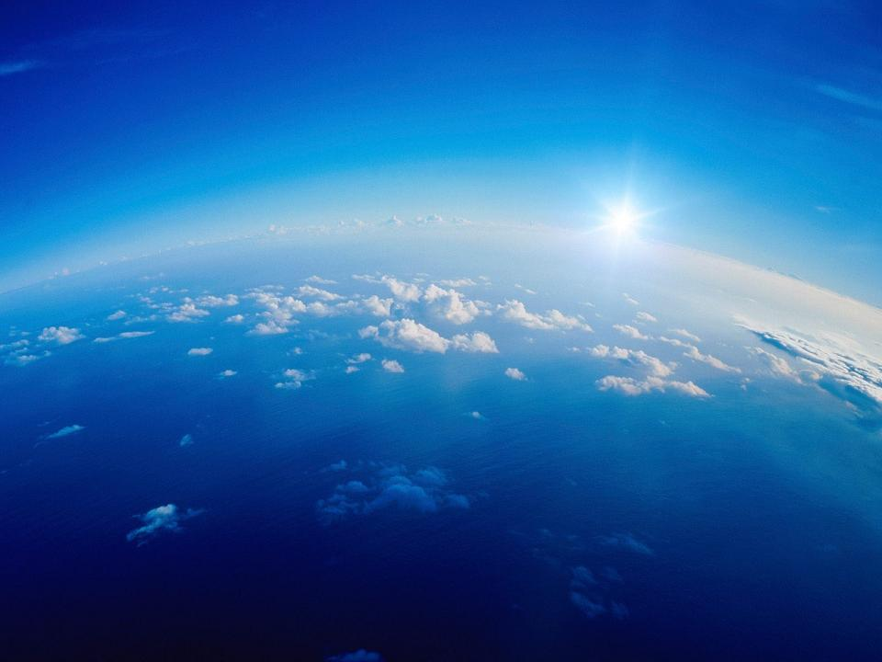
what a wonderful world.

Slide 33
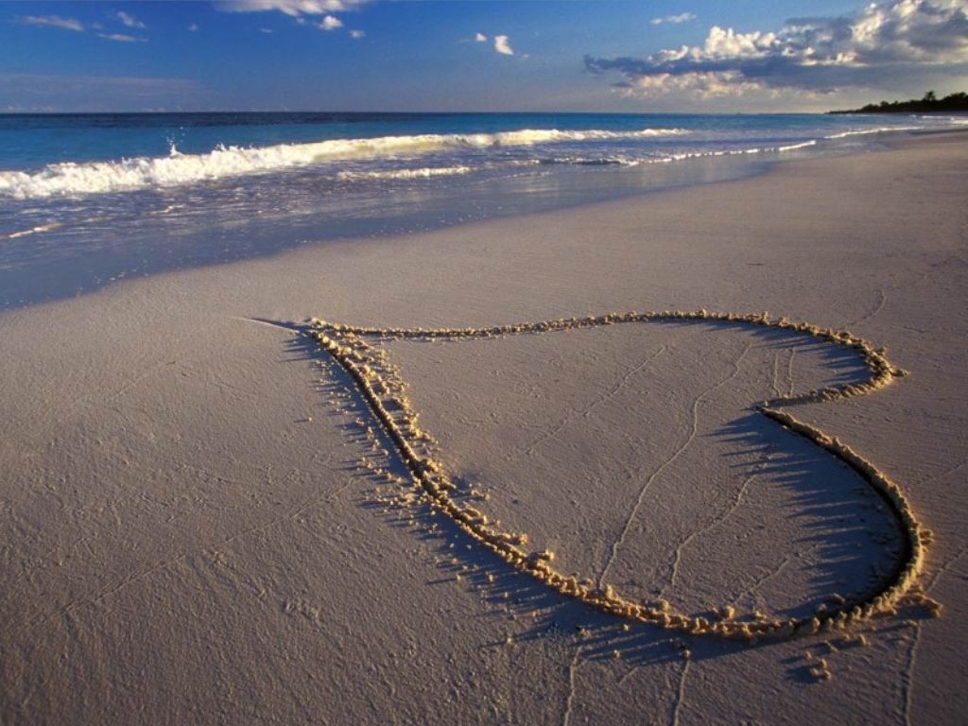
t@o

